Slide 1


HEP Weekly Report
George Bakas
NTUA

Slide 2
Comments
Checked Response Matrices once again
Problem with topPt and pT quantities
New Binning
TopPt: [400, 450, 520,600,700,800,1000,1500] → 7 bins
p_{T}: [0,80,220,360,500,650,800,1000] → 7 bins

Slide 3
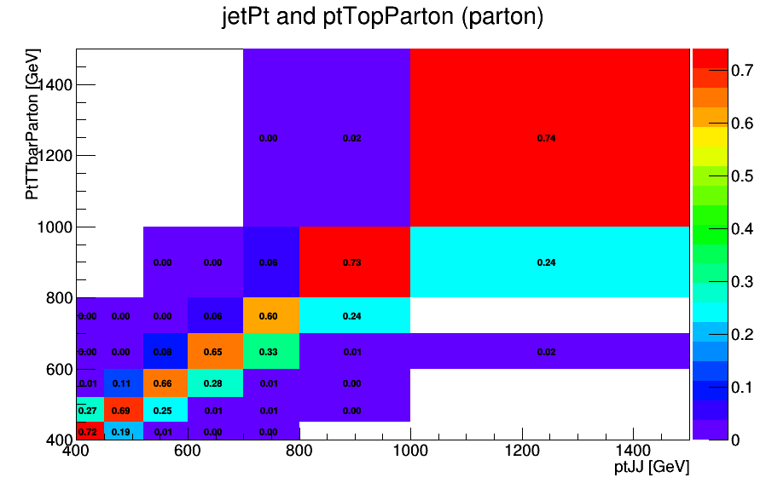
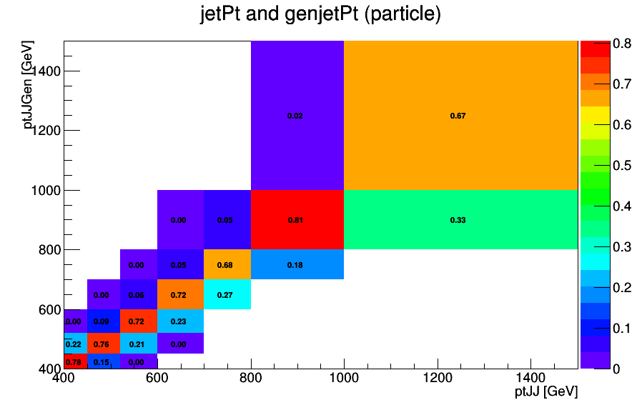
Response Matrices (Parton and Particle) for top p_{T}

Slide 4
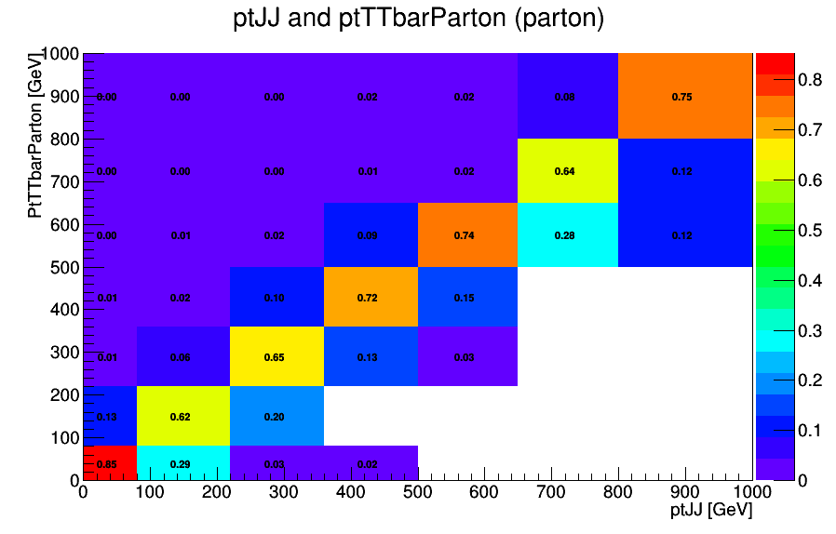
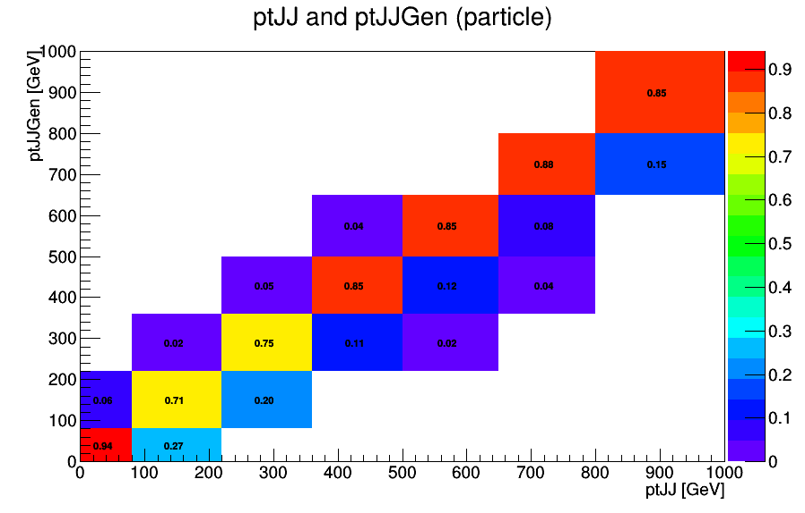
Response Matrices (Parton and Particle) for p_{T}

Slide 5
Parton and Particle Extrapolation
Now I will show parton and particle extrapolation for
Mass
Rapidity y
P_{T} (although binning will change ?)
For each of these quantities
Fraction of Final Extrapolation over Theoretical Histo
Final Extrapolation and Theoretical Histo
Unfolded and Yield (parton), Unfolded and Extrapolated Yield (particle)

Slide 6
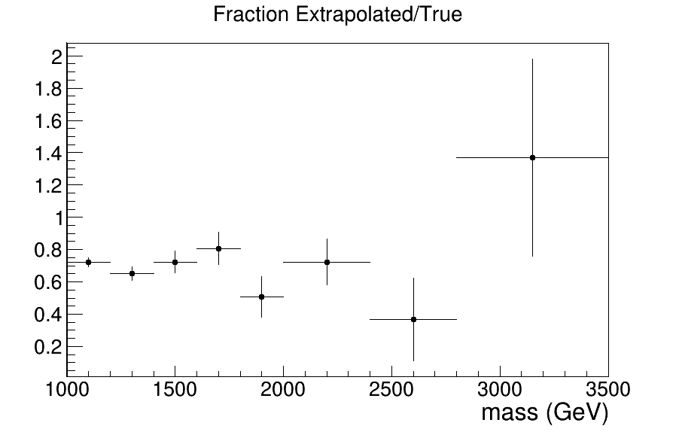
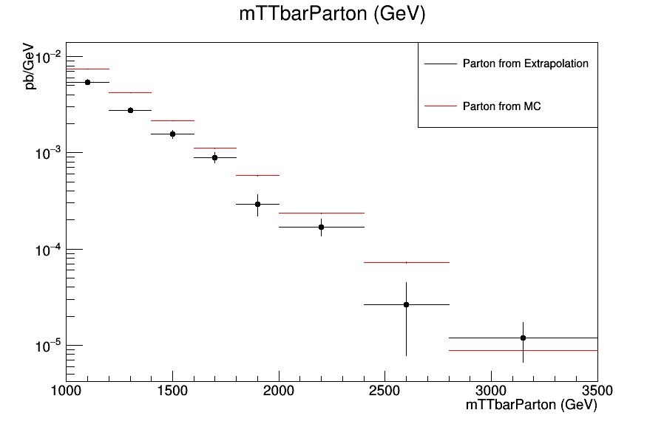
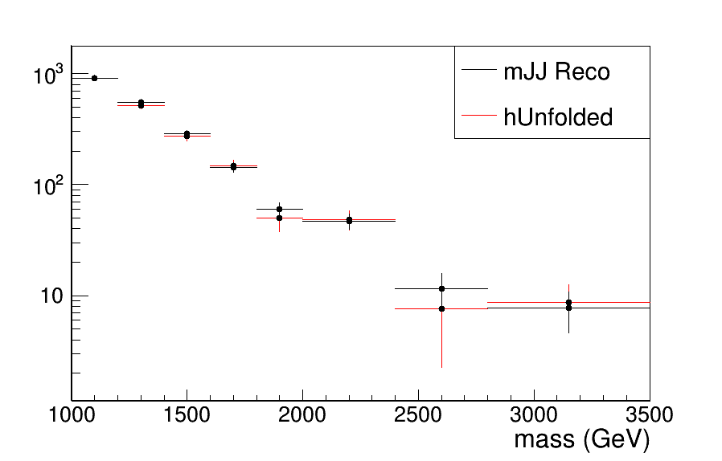
Mass Parton Extapolation
Fraction Of Extrapolated (and not unfolded!) over Theoretical
Extrapolated and Theoretical
Unfolded and Input

Slide 7
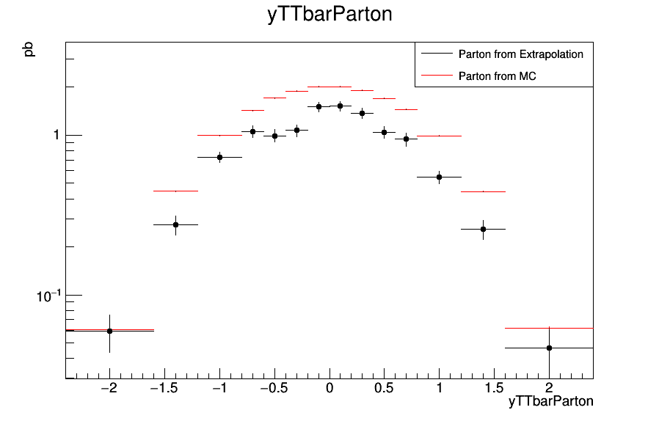
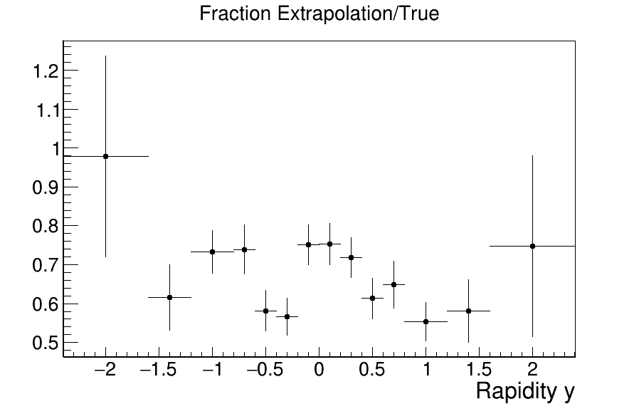
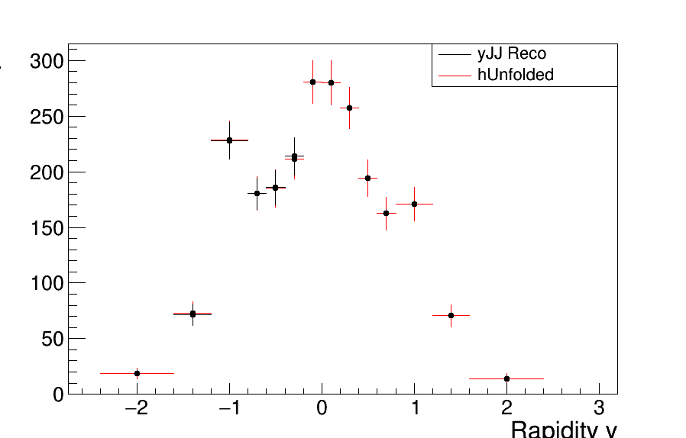
Rapidity Parton extrapolation
Fraction Of Extrapolated (and not unfolded!) over Theoretical
Extrapolated and Theoretical
Unfolded and Input

Slide 8
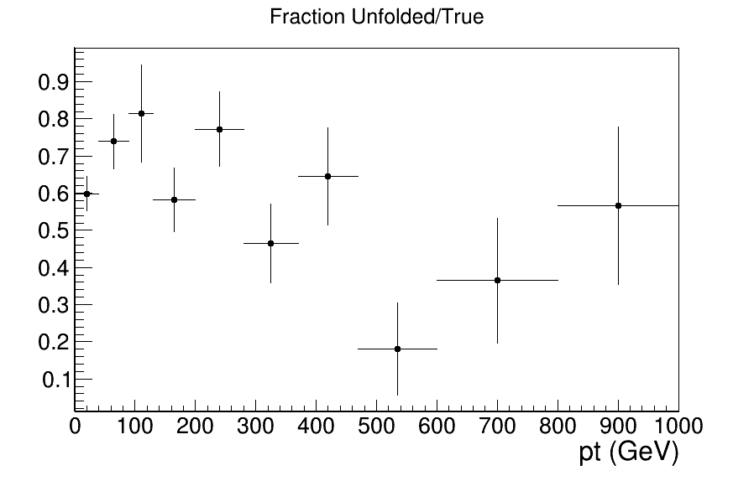
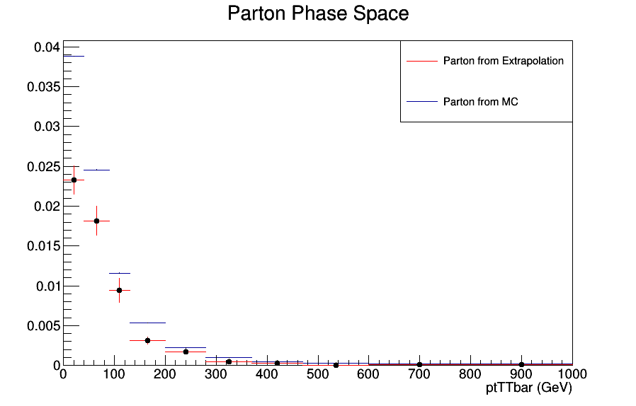
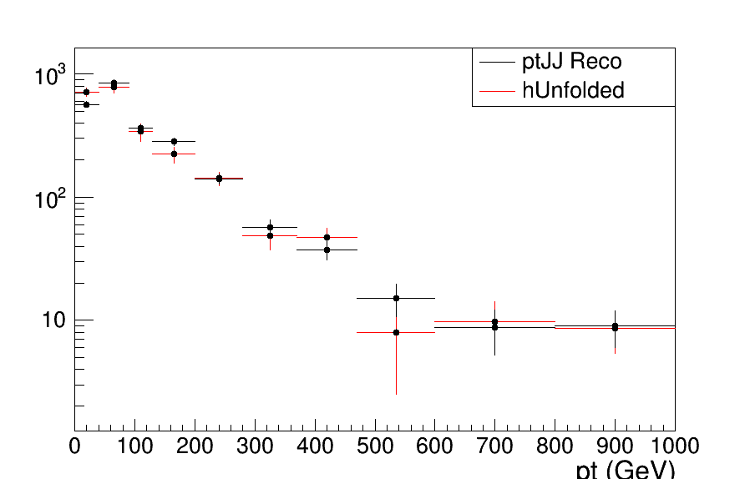
P_{T} Parton Extrapolation
Fraction Of Extrapolated (and not unfolded!) over Theoretical
Extrapolated and Theoretical
Unfolded and Input

Slide 9
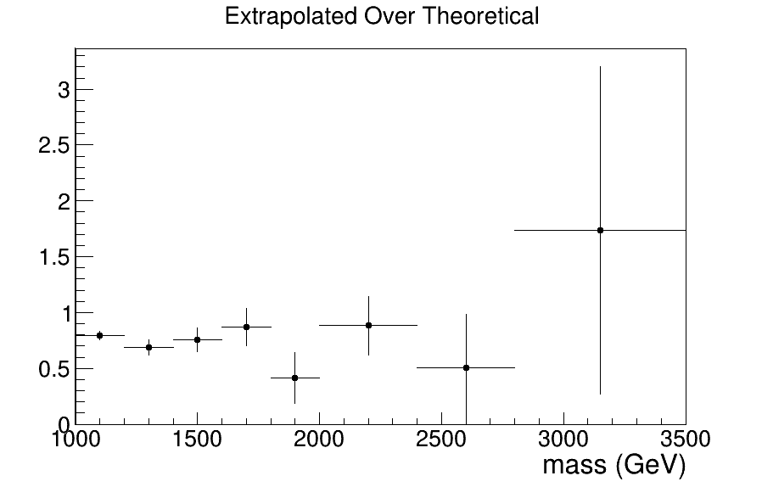
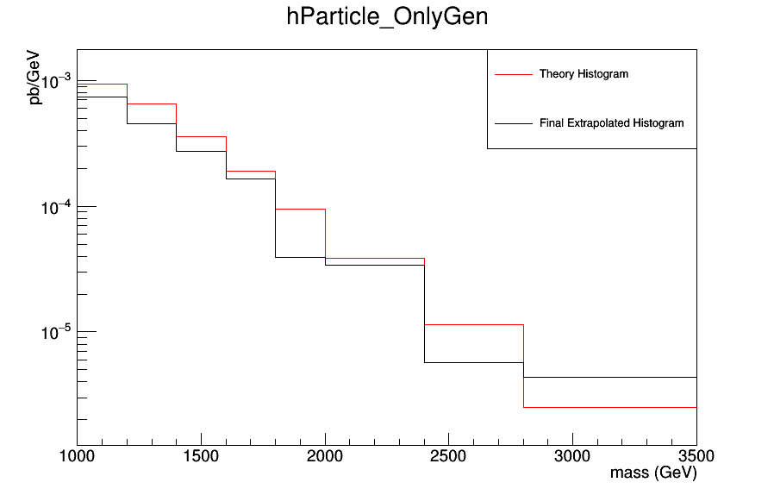
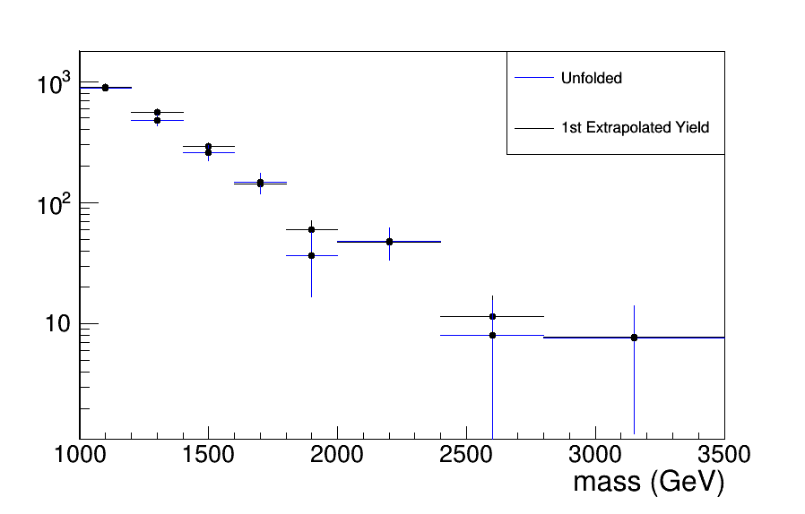
Mass Particle Extrapolation
Fraction Of Extrapolated (and not unfolded!) over Theoretical
Extrapolated and Theoretical
Unfolded and Extrapolated Input

Slide 10
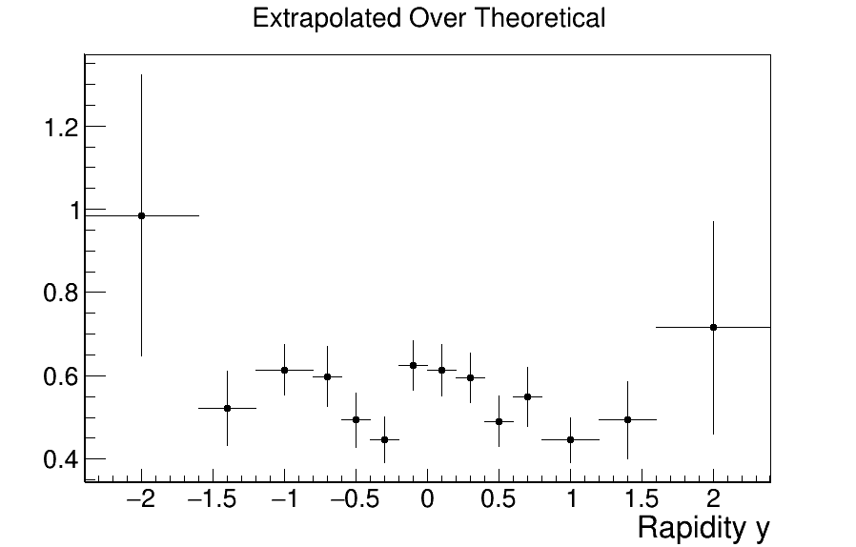
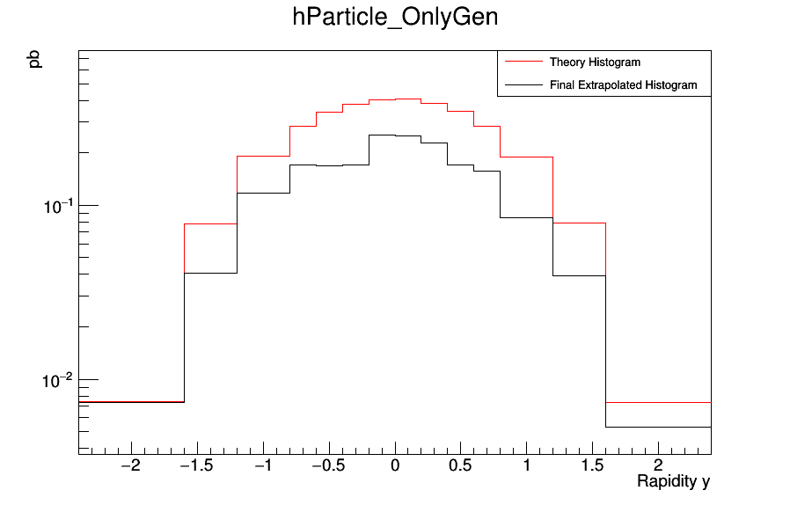
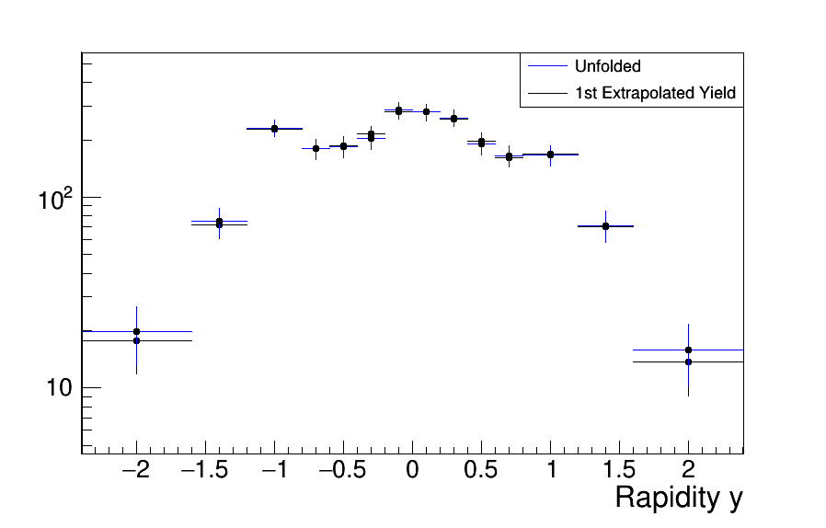
Rapidity Particle Extrapolation
Fraction Of Extrapolated (and not unfolded!) over Theoretical
Extrapolated and Theoretical
Unfolded and Extrapolated Input

Slide 11
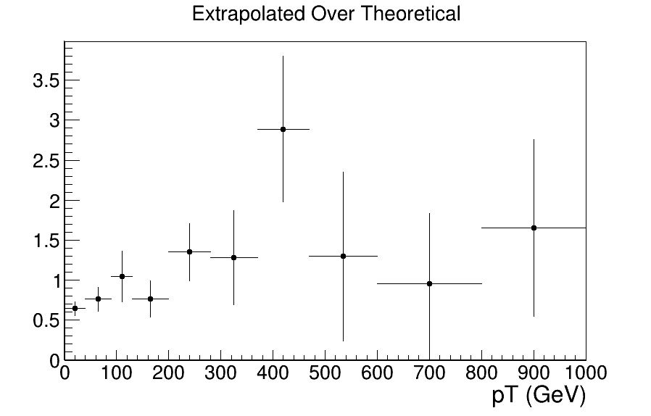
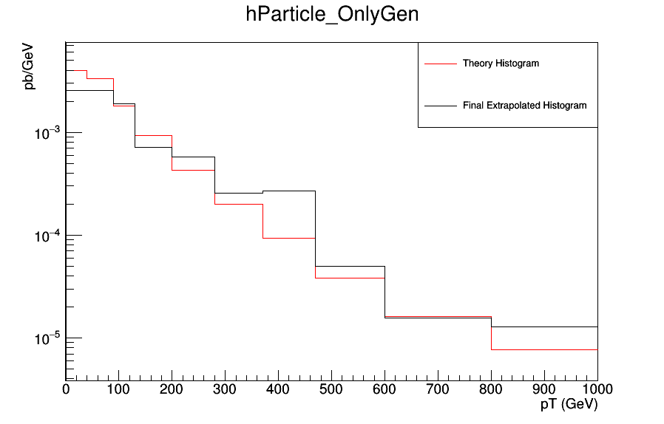
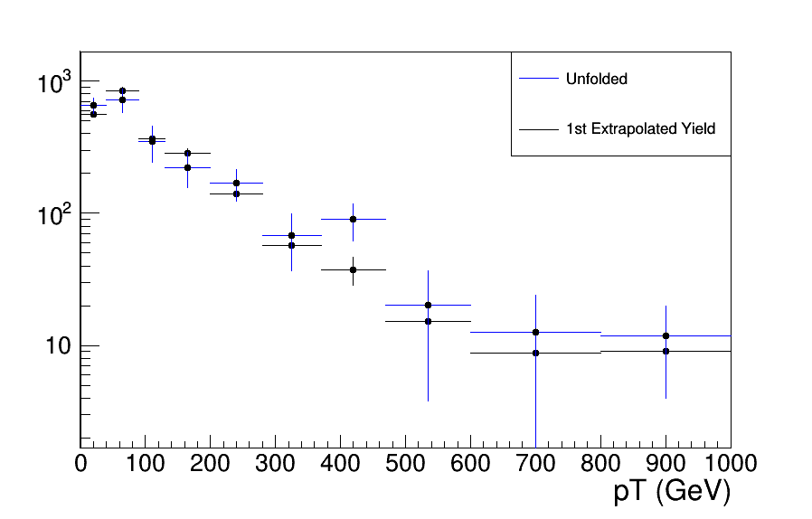
P_{T} Particle Extrapolation
Fraction Of Extrapolated (and not unfolded!) over Theoretical
Extrapolated and Theoretical
Unfolded and Extrapolated Input

